Slide 1

Chapter 2
Introduction to
XHTML

Slide 2
2.1 Origins and Evolution of HTML
HTML was defined with SGML
Original intent of HTML: General layout of documents that could be displayed by a wide variety of computers
Recent versions:
  HTML 4.0 – 1997
    Introduced many new features and deprecated many older features
  HTML 4.01 - 1999 - A cleanup of 4.0
  XHTML 1.0 - 2000
    Just 4.01 defined using XML, instead of SGML
  XHTML 1.1 – 2001
    Modularized 1.0, and drops frames
    We’ll stick to 1.1, except for frames

Slide 3
2.1 Origins and Evolution of HTML (continued)‏
Reasons to use XHTML, rather than HTML:
  HTML has lax syntax rules, leading to sloppy and sometime ambiguous documents
  – XHTML syntax is much more strict, leading to clean and clear documents in a standard form
  HTML processors do not even enforce the few syntax rule that do exist in HTML
  The syntactic correctness of XHTML documents can be validated
2.2 Basic Syntax
Elements are defined by tags (markers)‏
  Tag format:
    Opening tag: <name>
    Closing tag: </name>
  The opening tag and its closing tag together specify a container for the content they enclose

Slide 4
2.2 Basic Syntax (continued)‏
Not all tags have content
  If a tag has no content, its form is <name />
The container and its content together are called an element
If a tag has attributes, they appear between its name and the right bracket of the opening tag
Comment form: <!-- … -->
Browsers ignore comments, unrecognizable tags, line breaks, multiple spaces, and tabs
Tags are suggestions to the browser, even if they are recognized by the browser

Slide 5
2.3 HTML Document Structure
Every XHTML document must begin with:
  <?xml version = ″1.0″?>
  <!DOCTYPE html PUBLIC ″-//w3c//DTD XHTML 1.1//EN″
  http://www.w3.org/TR/xhtml11/DTD/xhtml11.dtd>
<html>, <head>, <title>, and <body> are required in every document
The whole document must have <html> as its root
html must have the xmlns attribute:
<html xmlns = ″http://www.w3.org/1999/xhtml″
A document consists of a head and a body
The <title> tag is used to give the document a title, which is normally displayed in the browser’s window title bar (at the top of the display)‏
Prior to XHTML 1.1, a document could have either a body or a frameset

Slide 6
2.4 Basic Text Markup
Text is normally placed in paragraph elements
Paragraph Elements
  The <p> tag breaks the current line and inserts a blank line - the new line gets the beginning of the content of the paragraph
  The browser puts as many words of the paragraph’s content as will fit in each line
  <?xml version = ″1.0″?>
  <!DOCTYPE html PUBLIC ″-//w3c//DTD XHTML 1.1//EN″
  http://www.w3.org/TR/xhtml11/DTD/xhtml11.dtd>
  <!-- greet.hmtl
  A trivial document
  -->
  <html xmlns = ″http://www.w3.org/1999/xhtml″>
  <head> <title> Our first document </title>
  </head>
  <body>
  <p>
  Greetings from your Webmaster!
  </p>
  </body>
  </html>

Slide 7
2.4 Basic Text Markup (continued)‏
W3C HTML Validation Service
  http://validator.w3.org/file-upload.html
Line breaks
  The effect of the <br /> tag is the same as that of <p>, except for the blank line
    No closing tag!
Example of paragraphs and line breaks
  On the plains of hesitation <p> bleach the
  bones of countless millions </p> <br />
  who, at the dawn of victory <br /> sat down
  to wait, and waiting, died.
Typical display of this text:
  On the plains of hesitation
  bleach the bones of countless millions
  who, at the dawn of victory
  sat down to wait, and waiting, died.

Slide 8
2.4 Basic Text Markup (continued)‏
Headings
  Six sizes, 1 - 6, specified with <h1> to <h6>
  1, 2, and 3 use font sizes that are larger than the default font size
  4 uses the default size
  5 and 6 use smaller font sizes
<!-- headings.html
An example to illustrate headings
-->
<html xmlns = ″http://www.w3.org/1999/xhtml″>
<head> <title> Headings </title>
</head>
<body>
<h1> Aidan’s Airplanes (h1) </h1>
<h2> The best in used airplanes (h2) </h2>
<h3> "We’ve got them by the hangarful" (h3)‏
</h3>
<h4> We’re the guys to see for a good used
airplane (h4) </h4>
<h5> We offer great prices on great planes
(h5) </h5>
<h6> No returns, no guarantees, no refunds,
all sales are final (h6) </h6>
</body>
</html>

Slide 9
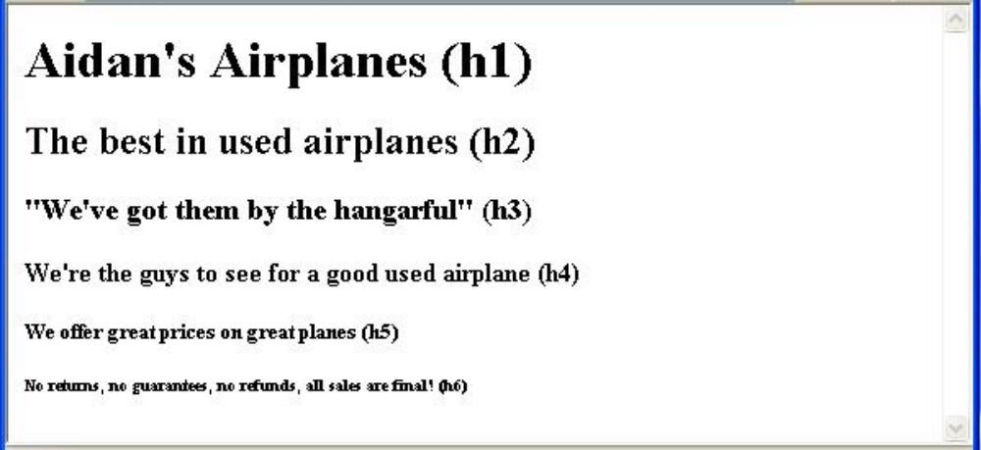
2.4 Basic Text Markup (continued)‏
Blockquotes
  Content of <blockquote>
  To set a block of text off from the normal flow and appearance of text
  Browsers often indent, and sometimes italicize
Font Styles and Sizes (can be nested)‏
  Boldface - <b>
  Italics - <i>
  Larger - <big>
  Smaller - <small>
  Monospace - <tt>

Slide 10
2.4 Basic Text Markup (continued)‏
  The <big> sleet <big> in <big> <i> Crete
  </i><br /> lies </big> completely </big>
  in </big> the street
  The sleet in Crete
  lies completely in the street
    These tags are not affected if they appear in the content of a <blockquote>, unless there is a conflict (e.g., italics)‏
  Superscripts and subscripts
    Subscripts with <sub>
    Superscripts with <sup>
  Example: x<sub>2</sub><sup>3</sup>
  Display: x₂³
Inline versus block elements
  Block elements CANNOT be nested in inline elements

Slide 11
2.4 Basic Text Markup (continued)‏
All of this font size and font style stuff can be done with style sheets, but these tags are not yet deprecated
Character Entities
Char. Entity Meaning
& &amp; Ampersand
< &lt; Less than
> &gt; Greater than
” &quot; Double quote
’ &apos; Single quote
¼ &frac14; One quarter
½ &frac12; One half
¾ &frac34; Three quarters
° &deg; Degree
(space) &nbsp; Non-breaking space
Horizontal rules
  <hr /> draws a line across the display, after a line break
The meta element (for search engines) Used to provide additional information about a document, with attributes, not content

Slide 12
2.5 Images
GIF (Graphic Interchange Format)‏
  8-bit color (256 different colors)‏
JPEG (Joint Photographic Experts Group)‏
  24-bit color (16 million different colors)‏
Both use compression, but JPEG compression is better
Images are inserted into a document with the <img /> tag with the src attribute
  The alt attribute is required by XHTML
    Purposes:
      Non-graphical browsers
      Browsers with images turned off
  <img src = "comets.jpg"
alt = "Picture of comets" />
The <img> tag has 30 different attributes, including width and height (in pixels)‏
Portable Network Graphics (PNG)‏
  Relatively new
  Should eventually replace both gif and jpeg

Slide 13
2.5 Images (continued)‏
<!-- image.html
An example to illustrate an image
-->
<html xmlns = ″http://www.w3.org/1999/xhtml″>
<head> <title> Images </title>
</head>
<body>
<h1> Aidan's Airplanes </h1>
<h2> The best in used airplanes </h2>
<h3> "We've got them by the hangarful"
</h3>
<h2> Special of the month </h2>
<p>
1960 Cessna 210 <br />
577 hours since major engine overhaul
<br />
1022 hours since prop overhaul
<br /><br />
<img src = "c210new.jpg"
alt = "Picture of a Cessna 210"/>
<br />
Buy this fine airplane today at a
remarkably low price <br />
Call 999-555-1111 today!
</p>
</body>
</html>

Slide 14
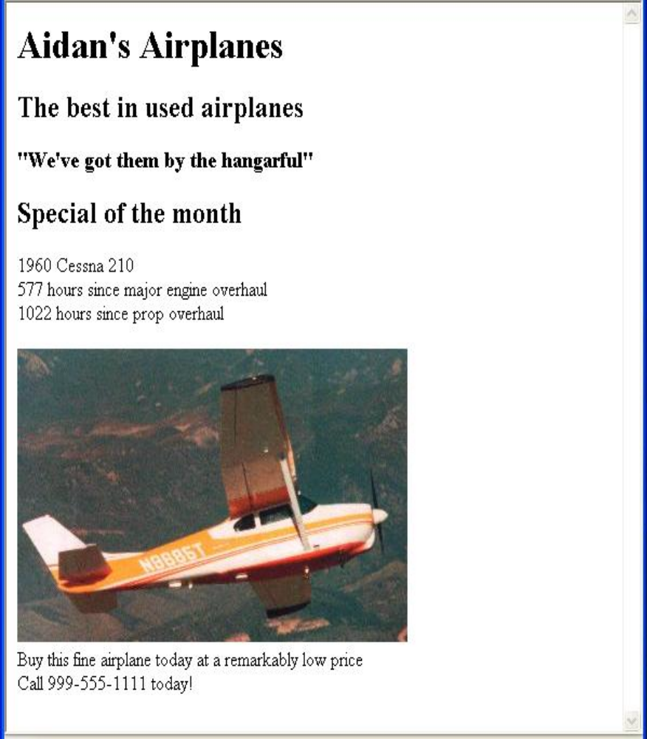
2.5 Images (continued)‏

Slide 15
2.6 Hypertext Links
Hypertext is the essence of the Web!
A link is specified with the href (hypertext reference) attribute of <a> (the anchor tag)‏
  The content of <a> is the visual link in the document
  If the target is a whole document (not the one in which the link appears), the target need not be specified in the target document as being the target
Note: Relative addressing of targets is easier to maintain and more portable than absolute addressing

Slide 16
2.6 Hypertext Links (continued)‏
<!-- link.html
An example to illustrate a link
-->
<html xmlns = ″http://www.w3.org/1999/xhtml″>
<head> <title> Links </title>
</head>
<body>
<h1> Aidan's Airplanes </h1>
<h2> The best in used airplanes </h2>
<h3> "We've got them by the hangarful"
</h3>
<h2> Special of the month </h2>
<p>
1960 Cessna 210 <br />
<a href = "C210data.html">
Information on the Cessna 210 </a>
</p>
</body>
</html>

Slide 17
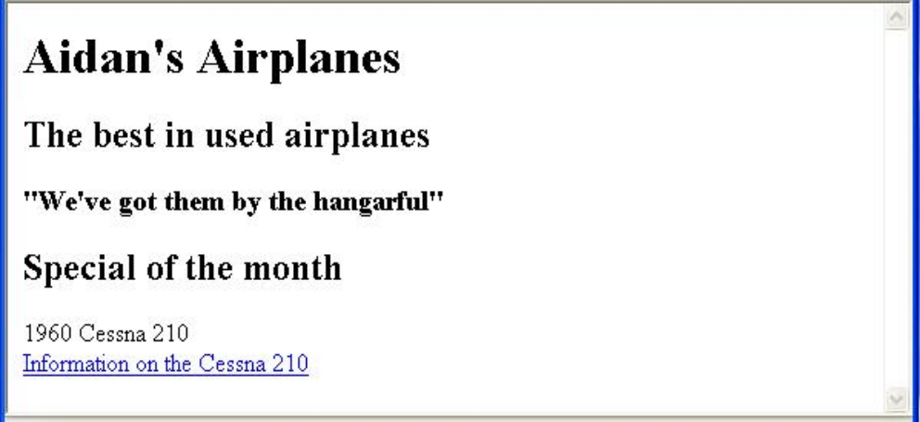
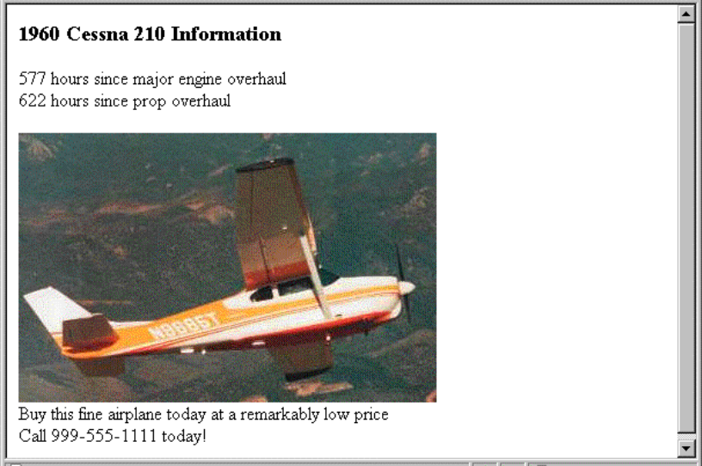
2.6 Hypertext Links (continued)‏

Slide 18
2.6 Hypertext Links (continued)‏
If the target is not at the beginning of the document, the target spot must be marked
Target labels can be defined in many different tags with the id attribute, as in
  <h1 id = "baskets"> Baskets </h1>
The link to an id must be preceded by a pound sign (#); If the id is in the same document, this target could be
  <a href = "#baskets">
What about baskets? </a>
If the target is in a different document, the document reference must be included
  <a href = "myAd.html#baskets”> Baskets </a>
Style note: a link should blend in with the surrounding text, so reading it without taking the link should not be made less pleasant
Links can have images:
<a href = "c210data.html“>
<img src = "smallplane.jpg"
alt = "Small picture of an airplane " />
Info on C210 </a>

Slide 19
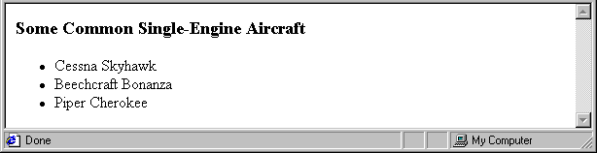
2.7 Lists
Unordered lists
The list is the content of the <ul> tag
List elements are the content of the <li> tag
<h3> Some Common Single-Engine Aircraft </h3>
<ul>
<li> Cessna Skyhawk </li>
<li> Beechcraft Bonanza </li>
<li> Piper Cherokee </li>
</ul>
Ordered lists
  The list is the content of the <ol> tag
  Each item in the display is preceded by a sequence value

Slide 20
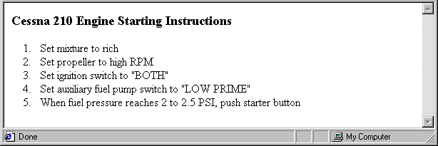
2.7 Lists (continued)‏
<h3> Cessna 210 Engine Starting Instructions
</h3>
<ol>
<li> Set mixture to rich </li>
<li> Set propeller to high RPM </li>
<li> Set ignition switch to "BOTH" </li>
<li> Set auxiliary fuel pump switch to
"LOW PRIME" </li>
<li> When fuel pressure reaches 2 to 2.5
PSI, push starter button </li>
</ol>
Nested lists
  Any type list can be nested inside any type list
  The nested list must be in a list item

Slide 21
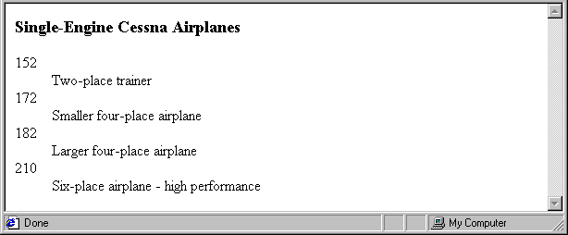
2.7 Lists (continued)‏
Definition lists (for glossaries, etc.)‏
  List is the content of the <dl> tag
  Terms being defined are the content of the <dt> tag
  The definitions themselves are the content of the <dd> tag
<h3> Single-Engine Cessna Airplanes </h3>
<dl >
<dt> 152 </dt>
<dd> Two-place trainer </dd>
<dt> 172 </dt>
<dd> Smaller four-place airplane </dd>
<dt> 182 </dt>
<dd> Larger four-place airplane </dd>
<dt> 210 </dt>
<dd> Six-place airplane - high performance
</dd>
</dl>

Slide 22
2.8 Tables
A table is a matrix of cells, each possibly having content
The cells can include almost any element
Some cells have row or column labels and some have data
A table is specified as the content of a <table> tag
A border attribute in the <table> tag specifies a border between the cells
If border is set to "border", the browser’s default width border is used
The border attribute can be set to a number, which will be the border width
Without the border attribute, the table will have no lines!
Tables are given titles with the <caption> tag, which can immediately follow <table>

Slide 23
2.8 Tables (continued)‏
Each row of a table is specified as the content of a <tr> tag
The row headings are specified as the content of a <th> tag
The contents of a data cell is specified as the content of a <td> tag
<table border = "border">
<caption> Fruit Juice Drinks </caption>
<tr>
<th> </th>
<th> Apple </th>
<th> Orange </th>
<th> Screwdriver </th>
</tr>
<tr>
<th> Breakfast </th>
<td> 0 </td>
<td> 1 </td>
<td> 0 </td>
</tr>
<tr>
<th> Lunch </th>
<td> 1 </td>
<td> 0 </td>
<td> 0 </td>
</tr>
</table>

Slide 24
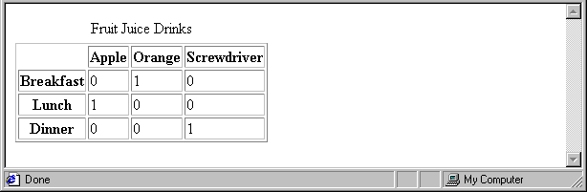
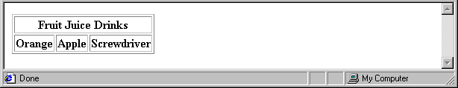
2.8 Tables (continued)‏
A table can have two levels of column labels
  If so, the colspan attribute must be set in the <th> tag to specify that the label must span some number of columns
<tr>
<th colspan = "3"> Fruit Juice Drinks </th>
</tr>
<tr>
<th> Orange </th>
<th> Apple </th>
<th> Screwdriver </th>
</tr>

Slide 25
2.8 Tables (continued)‏
If the rows have labels and there is a spanning column label, the upper left corner must be made larger, using rowspan
<table border = "border">
<tr>
<td rowspan = "2"> </td>
<th colspan = "3"> Fruit Juice Drinks
</th>
</tr>
<tr>
<th> Apple </th>
<th> Orange </th>
<th> Screwdriver </th>
</tr>
…
</table>

Slide 26
2.8 Tables (continued)‏
The align attribute controls the horizontal placement of the contents in a table cell
  Values are left, right, and center (default)‏
  align is an attribute of <tr>, <th>, and <td> elements
The valign attribute controls the vertical placement of the contents of a table cell
  Values are top, bottom, and center (default)‏
  valign is an attribute of <th> and <td> elements
  → SHOW cell_align.html and display it
The cellspacing attribute of <table> is used to specify the distance between cells in a table
The cellpadding attribute of <table> is used to specify the spacing between the content of a cell and the inner walls of the cell

Slide 27
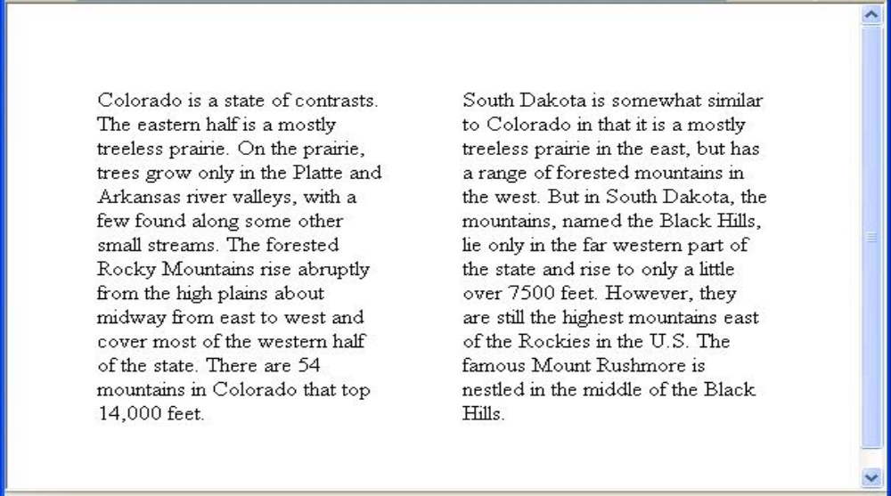
2.8 Tables (continued)‏
<table cellspacing = "50">
<tr>
<td> Colorado is a state of …
</td>
<td> South Dakota is somewhat…
</td>
</tr>
</table>
Table Sections
  Header, body, and footer, which are the elements: thead, tbody, and tfoot
  If a document has multiple tbody elements, they are separated by thicker horizontal lines

Slide 28
2.9 Forms
A form is the usual way information is gotten from a browser to a server
HTML has tags to create a collection of objects that implement this information gathering
  The objects are called widgets (e.g., radio buttons and checkboxes)‏
When the Submit button of a form is clicked, the form’s values are sent to the server
All of the widgets, or components of a form are defined in the content of a <form> tag
  The only required attribute of <form> is action, which specifies the URL of the application that is to be called when the Submit button is clicked
  action =
  "http://www.cs.ucp.edu/cgi-bin/survey.pl"
    If the form has no action, the value of action is the empty string

Slide 29
2.9 Forms (continued)‏
The method attribute of <form> specifies one of the two possible techniques of transferring the form data to the server, get and post
  get and post are discussed in Chapter 10
Widgets
  Many are created with the <input> tag
    The type attribute of <input> specifies the kind of widget being created
    Text
      Creates a horizontal box for text input
      Default size is 20; it can be changed with the size attribute
      If more characters are entered than will fit, the box is scrolled (shifted) left

Slide 30
2.9 Forms (continued)‏
  If you don’t want to allow the user to type more characters than will fit, set maxlength, which causes excess input to be ignored
    <input type = "text" name = "Phone"
    size = "12" >
2. Checkboxes - to collect multiple choice input
  Every checkbox requires a value attribute, which is the widget’s value in the form data when the checkbox is ‘checked’
    A checkbox that is not ‘checked’ contributes no value to the form data
  By default, no checkbox is initially ‘checked’
  To initialize a checkbox to ‘checked’, the checked attribute must be set to "checked"

Slide 31
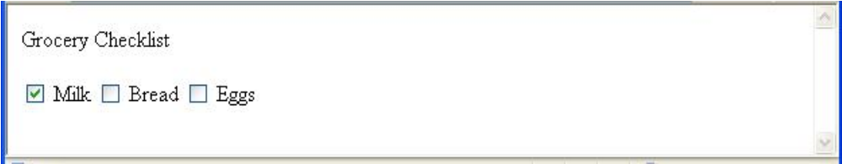
2.9 Forms (continued)‏
Widgets (continued)‏
Grocery Checklist
<form action = "">
<p>
<input type = "checkbox" name ="groceries"
value = "milk" checked = "checked">
Milk
<input type = "checkbox" name ="groceries"
value = "bread">
Bread
<input type = "checkbox" name = "groceries"
value= "eggs">
Eggs
</p>
</form>
3. Radio Buttons - collections of checkboxes in which only one button can be ‘checked’ at a time
    Every button in a radio button group MUST have the same name

Slide 32
2.9 Forms (continued)‏
Widgets (continued)‏
3. Radio Buttons (continued)‏
  If no button in a radio button group is ‘pressed’, the browser often ‘presses’ the first one
Age Category
<form action = "">
<p>
<input type = "radio" name = "age"
value = "under20" checked = "checked"> 0-19
<input type = "radio" name = "age"
value = "20-35"> 20-35
<input type = "radio" name = "age"
value = "36-50"> 36-50
<input type = "radio" name = "age"
value = "over50"> Over 50
</p>
</form>

Slide 33
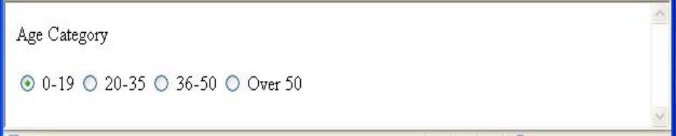
2.9 Forms (continued)‏
3. Menus - created with <select> tags
There are two kinds of menus, those that behave like checkboxes and those that behave like radio buttons (the default)‏
  Menus that behave like checkboxes are specified by including the multiple attribute, which must be set to "multiple"
The name attribute of <select> is required
The size attribute of <select> can be included to specify the number of menu items to be displayed (the default is 1)‏
  If size is set to > 1 or if multiple is specified, the menu is displayed as a pop-up menu

Slide 34
2.9 Forms (continued)‏
Widgets (continued)‏
3. Menus (continued)‏
  Each item of a menu is specified with an <option> tag, whose pure text content (no tags) is the value of the item
  An <option> tag can include the selected attribute, which when assigned "selected” specifies that the item is preselected
Grocery Menu - milk, bread, eggs, cheese
<form action = "">
<p>
With size = 1 (the default)‏
<select name = "groceries">
<option> milk </option>
<option> bread </option>
<option> eggs </option>
<option> cheese </option>
</select>
</p>
</form>

Slide 35
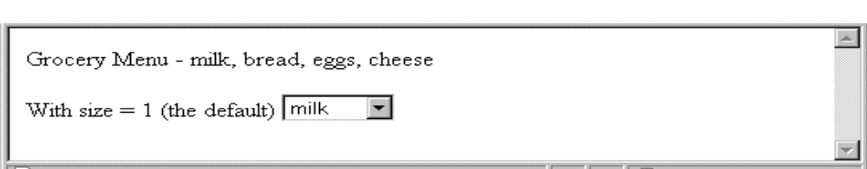
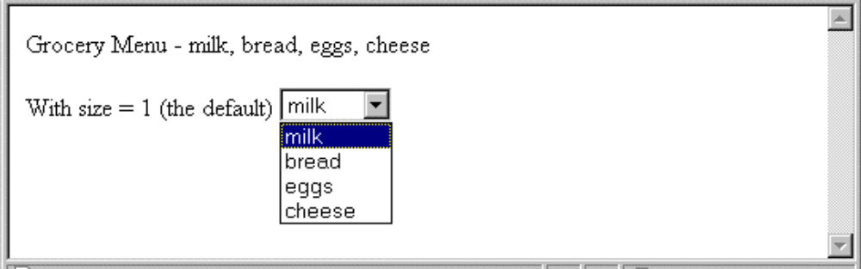
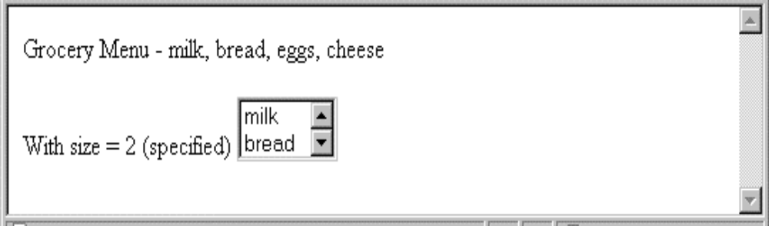
2.9 Forms (continued)‏
Widgets (continued)‏
After clicking the menu:
After changing size to 2:

Slide 36
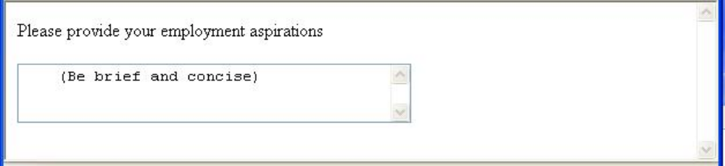
2.9 Forms (continued)‏
Widgets (continued)‏
5. Text areas - created with <textarea>
  Usually include the rows and cols attributes to specify the size of the text area
  Default text can be included as the content of <textarea>
  Scrolling is implicit if the area is overfilled
Please provide your employment aspirations
<form action = "">
<p>
<textarea name = "aspirations" rows = "3”
cols = "40">
(Be brief and concise)
</textarea>
</p>
</form>

Slide 37
2.9 Forms (continued)‏
Widgets (continued)‏
6. Reset and Submit buttons
  Both are created with <input>
<input type = "reset" value = "Reset Form">
<input type = "submit” value = "Submit Form">
Submit has two actions:
  Encode the data of the form
  Request that the server execute the server-resident program specified as the value of the action attribute of <form>
  A Submit button is required in every form
--> SHOW popcorn.html and display it

Slide 38
2.10 Frames
Frames are rectangular sections of the display window, each of which can display a different document
Because frames are no longer part of XHTML, you cannot validate a document that includes frames
The <frameset> tag specifies the number of frames and their layout in the window
  <frameset> takes the place of <body>
  Cannot have both!
  <frameset> must have either a rows attribute or a cols attribute, or both (usually the case)‏
  Default is 1
  The possible values for rows and cols are numbers, percentages, and asterisks
    A number value specifies the row height in pixels - Not terribly useful!
    A percentage specifies the percentage of total window height for the row - Very useful!

Slide 39
2.10 Frames (continued)‏
  An asterisk after some other specification gives the remainder of the height of the window
  Examples:
  <frameset rows = "150, 200, 300">
  <frameset rows = "25%, 50%, 25%">
  <frameset rows = "50%, 20%, *" >
  <frameset rows = "50%, 25%, 25%"
  cols = "40%, *">
The <frame> tag specifies the content of a frame
The first <frame> tag in a <frameset> specifies the content of the first frame, etc.
  Row-major order is used
  Frame content is specified with the src attribute
  Without a src attribute, the frame will be empty (such a frame CANNOT be filled later)‏
If <frameset> has fewer <frame> tags than frames, the extra frames are empty

Slide 40
2.10 Frames (continued)‏
Scrollbars are implicitly included if needed (they are needed if the specified document will not fit)‏
If a name attribute is included, the content of the frame can be changed later (by selection of a link in some other frame)‏
→SHOW frames.html
Note: the Frameset standard must be specified in the DOCTYPE declaration

Slide 41
2.10 Frames (continued)‏
<!-- contents.html
The contents of the first frame of
frames.html, which is the table of
contents for the second frame
-->
<html xmlns = ″http://www.w3.org/1999/xhtml″>
<head> <title> Table of Contents Frame
</title>
</head>
<body>
<h4> Fruits </h4>
<ul>
<li> <a href = "apples.html"
target = "descriptions">
apples </a>
<li> <a href = "bananas.html"
target = "descriptions">
bananas </a>
<li> <a href = "oranges.html"
target = "descriptions">
oranges </a>
</ul>
</body>
</html>

Slide 42
2.10 Frames (continued)‏
Nested frames - to divide the screen in more interesting ways
→ SHOW nested_frames.html
2.11 Syntactic Differences between HTML & XHTML
Case sensitivity
Closing tags
Quoted attribute values
Explicit attribute values
id and name attributes
Element nesting

